Slide 1
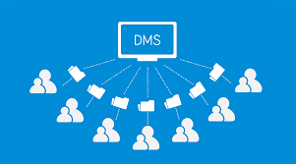
Document Management System

Slide 2

Team Members
Chirag Gupta (19z207)
Darwin Debbarma (19z208)
Gowtham T (19z214)
Varun Bharadwaj (19z256)
Mathana Sekaran T (19z264)
Guide:
Adelene Anusha

Slide 3

OUTLINE
Problem statement
Industry
Motivation
Objective
Literature survey
References

Slide 4
Problem statement
Topic :Document management system
A good document management system can help organize all of your files and data in one place, keep track of all of your critical documents, speed up your workflow, improve accuracy and provide around-the-clock access to documents from any part of the world.
Documents are often scattered all over the place on your digital devices- you may have Word files, files stored in cloud apps like Dropbox, Google Drive, OneDrive, Box, files stored on your desktop, email attachments, and so on.
Managing this digital mess, which is often unstructured, and making it available to your employees, clients, partners or other stakeholders is no easy task. So to increase their efficiency the document management system is made.

Slide 5
Motivation
A document management system or DMS is a system or process, which is used to capture, track, and store e-documents, such as PDFs, word processing files, and digital images of paper-based content. The study offers an analysis of various end-users who utilize DMS, and the latest developments by companies, which is driving the growth of the market. As unorganized content makes it difficult for larger organizations to extract business-related information and use available data, DMS proves very effective in overcoming these challenges.

Slide 6
Industry
Tiruppur District Judiciary

Slide 7

Objective
1. Feeding provision for each communication (either Circulars, Official Memorandum, Transfer Orders, etc.,) .
2. Tracking of files using unique code (Bar Code).
3. Separate Module for High Court to District Court communication.
4. Separate Module for District Court to other subordinate Court communication.
5. Separate Module for other subordinate Court to District Court communication.
6. Reminders and alert notifications
7. Status Tracking provision for each letter.
8. Report generation module for various statements based on requirements.

Slide 8
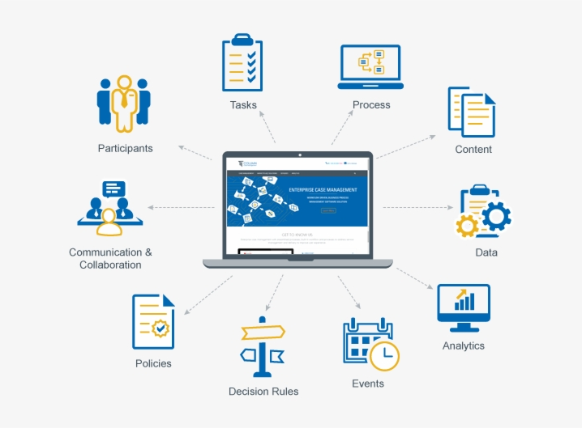
Literature survey and references
https://www.mordorintelligence.com/industry-reports/document-management-systems-market
https://www.aiim.org/what-is-document-imaging
https://blog.bit.ai/document-management/
https://www.academia.edu/38513329/Challenges_and_opportunities_brought_by_the_use_of_the_Document_Management_System_at_the
https://www.dotcompliance.com/blog/

